Slide 1
Problems in OOP
Vu Tuan Hai

Slide 2
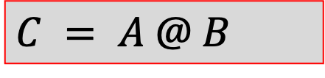
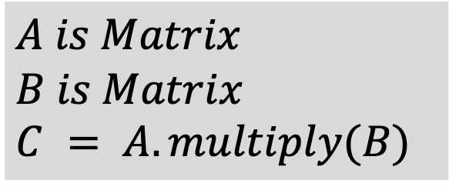
Overload operator (1/3)
Replace method() by operator+-*/…
Pros:
Shorter
Better representation
Cons:
- Misunderstanding in large projects
$A is Matrix$
$B is Matrix$
$C = A.multiply(B)$
$C = A @ B$
Look simple, but what is the meaning of @?

Slide 3
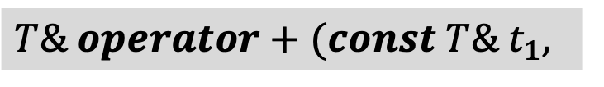
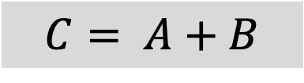
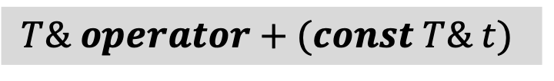
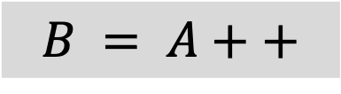
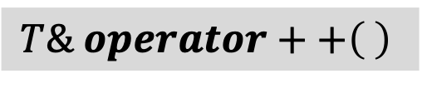
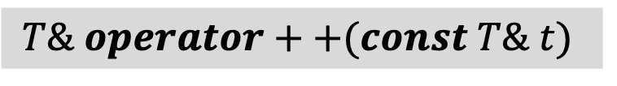
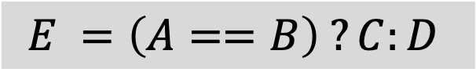
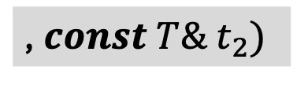
Overload operator (2/3)
???
We already know that there are some type of operators:
Unary (a function that require only 1 input)
Binary (a function that require only 2 inputs)
Tenary (a function that require only 3 inputs)
Example
In C++
$$T\& operator++\left( \right)$$
Inner class
$$B = A++$$
$$T\& operator++(const T\& t)$$
1
Outer class
$$C= A+B$$
$$T\& operator+(const T\& t)$$
1
2
Inner class
$$T\& operator+(const T\& t_{1},$$
$$E =\left(A==B\right) ?C:D$$
, $const T\& t_{2})$
Outer class
1
2
3
IMPOSSIBLE
I do not teach much about overload operator in C++ because of its range of application.
BUT your should learn by yourself for the final examination.

Slide 4
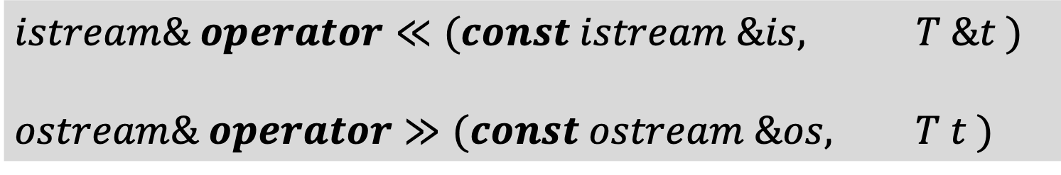
Overload operator (3/3)
Note that
$$istream\& operator≪(const istream \&is, T \&t )$$
$$ostream\& operator≫(const ostream \&os, T t )$$
Who is he/she?
Why diff?
Why must the i/ostream operator be overloaded outside the class?

Slide 5
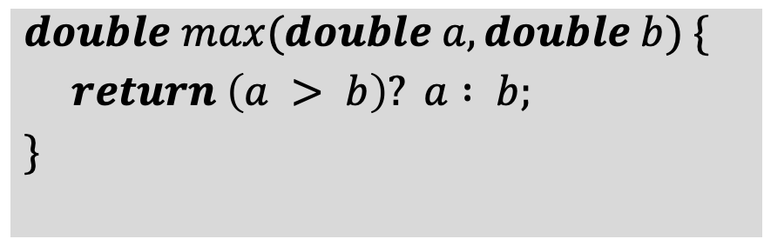
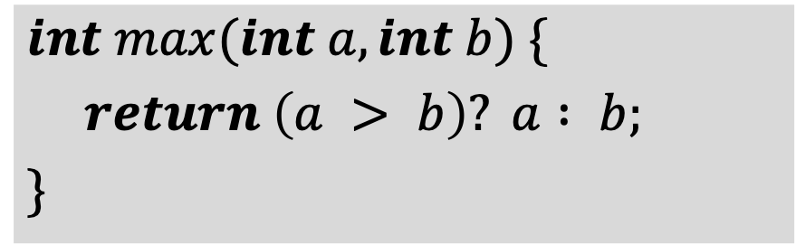
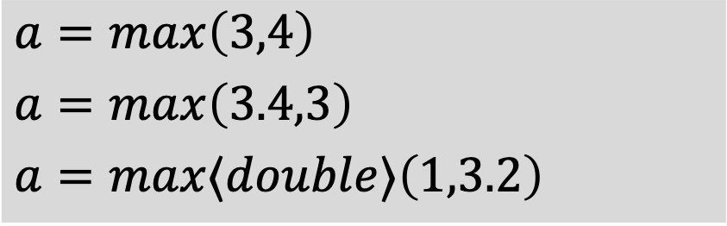

Template (1/3) (Generic programming)
Anything!
$template⟨typename T⟩$
$T max(T a, T b) \{$
$return \left(a > b\right)? a : b;$
$\}$
$int max(int a, int b) \{$
$return \left(a > b\right)? a : b;$
$\}$
General logic with type T
Note that T must be comparable type
$double max(double a, double b) \{$
$return \left(a > b\right)? a : b;$
$\}$
$a=\max\left(3,4\right)$
$a=\max\left(3.4,3\right)$
$a=max⟨double⟩\left(1,3.2\right)$
Automatically inference
Same logic, diff type
Failed
Explicity

Slide 6
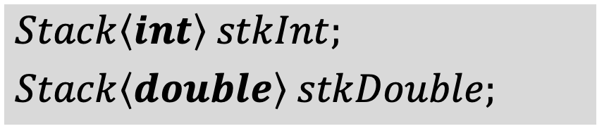
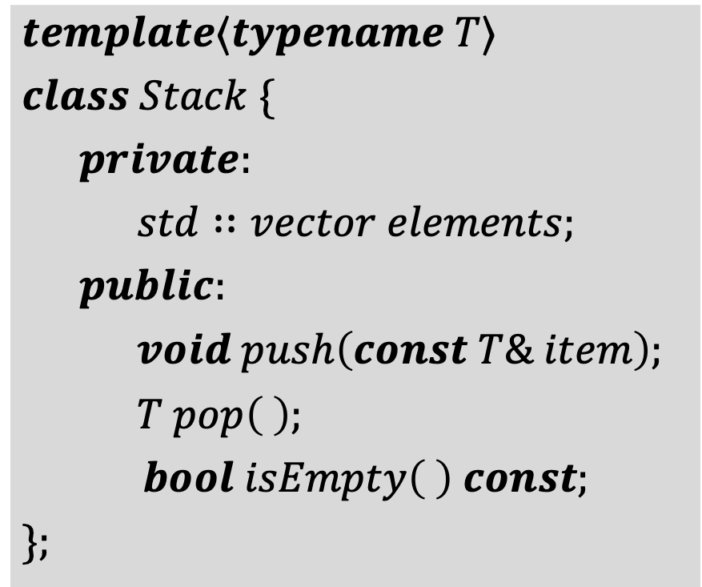
Template (2/3) (Generic programming)
$template⟨typename T⟩$
$class Stack \{$
$private:$
$std∷vector elements;$
$public:$
$void push\left(const T\& item\right);$
$T pop\left( \right);$
$bool isEmpty\left( \right) const;$
$\};$
$Stack\left\langle int\right\rangle stkInt;$
$Stack\left\langle double\right\rangle stkDouble;$

Slide 7
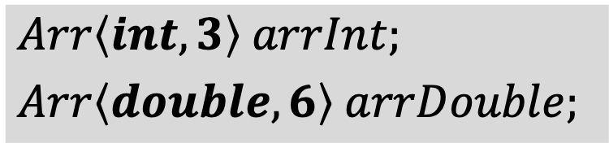
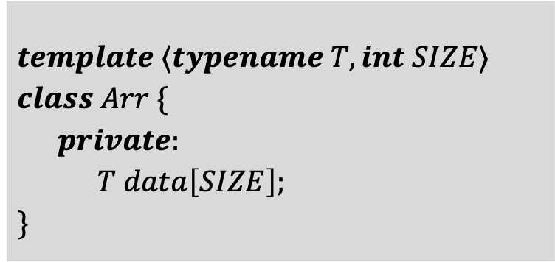

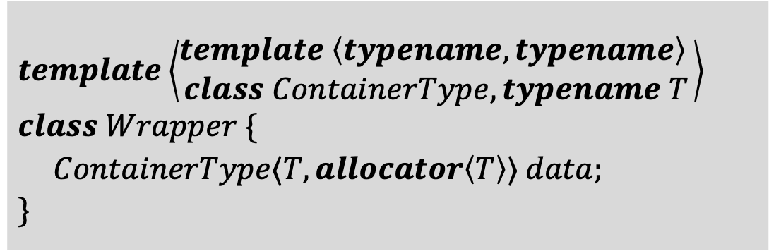
Template (3/3) (Generic programming)
$template ⟨typename T, int SIZE⟩$
$class Arr \{$
$private:$
$T data\left[SIZE\right];$
$\}$
$template\left\langle \begin{aligned}template \left\langle typename, typename\right\rangle \\ class ContainerType, typename T\end{aligned}\right\rangle$
$class Wrapper \{$
$ContainerType⟨T, allocator\left\langle T\right\rangle ⟩ data;$
$\}$
$Arr\left\langle int,3\right\rangle arrInt;$
$Arr\left\langle double,6\right\rangle arrDouble;$
$Wrapper\left\langle vector, int\right\rangle w_{1};$
Note-type parameter
Template template parameter
Other definitions: concepts, template metaprogramming, variadic template, …

Slide 8
Design pattern
Creational Patterns
Singleton
Factory Method
Abstract Factory
Builder
Prototype
Structural Patterns
Composite
Decorator
Facade
Flyweight
Proxy
Behavioral Patterns
- Chain of responsibility
Command
Iterator
Mementor
Dependence injection
Repository Pattern

Slide 9
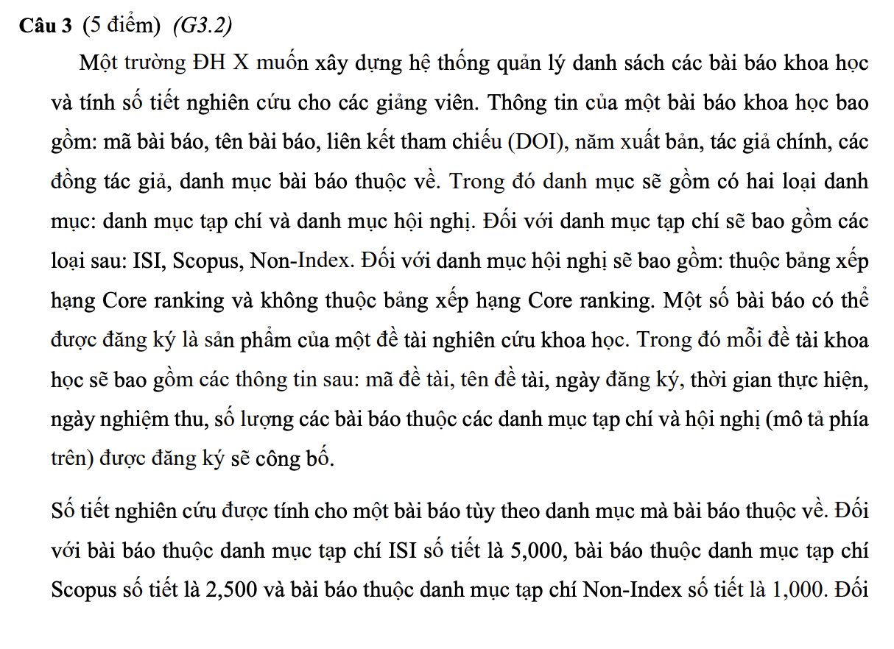
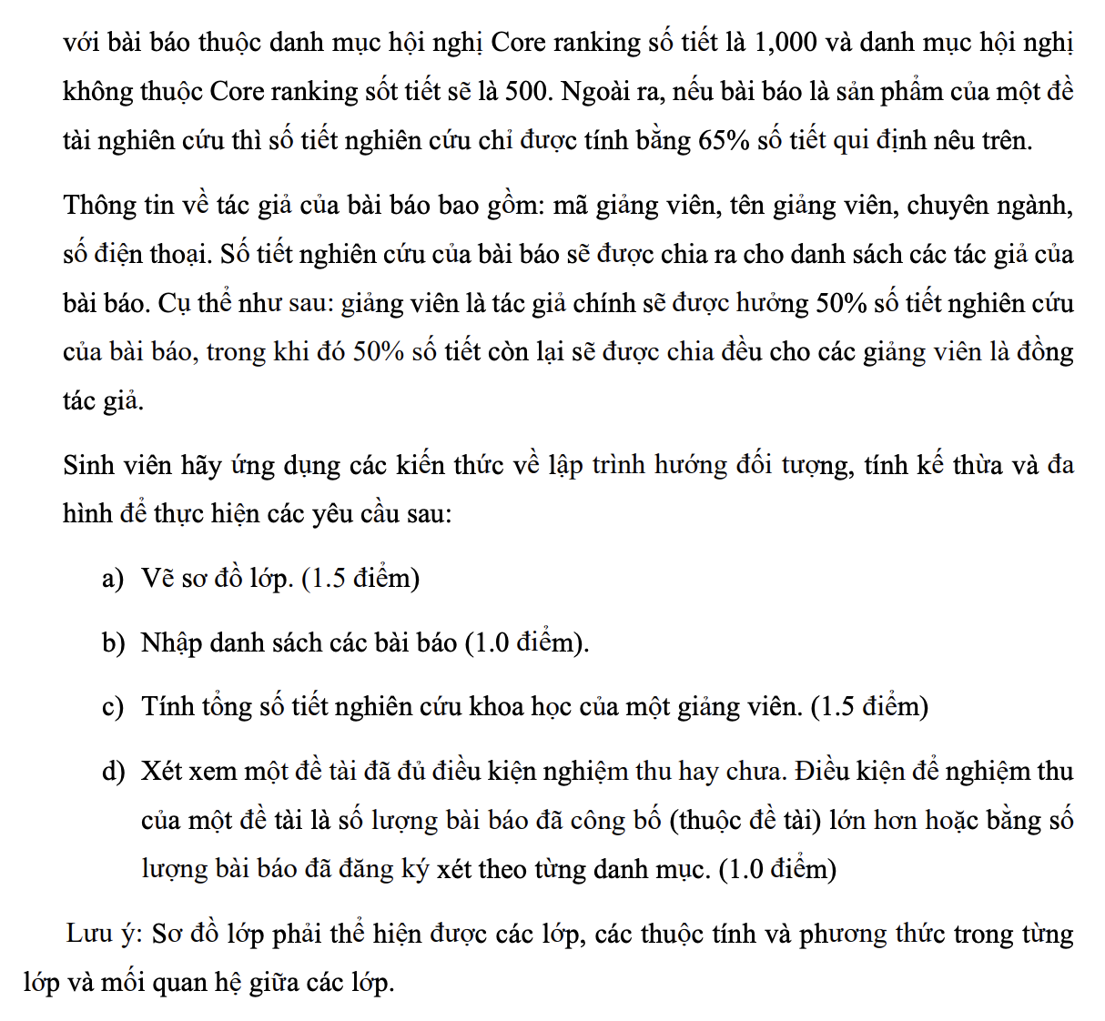

Slide 10
